Slide 1
Power-Performance-Area Trade-offs in FPGA-Based FIR Accelerators
A Comprehensive Architectural Analysis
Saptarshi Pal, Rounak Roy Choudhury, Gopesh Saha
Supervised by Dr. Hemanta Kumar Mondal & Dr. Rajashree Das
NIT Durgapur | May 2026

Slide 2
The Hardware Multiplier Problem
• Edge computing & signal processing rely heavily on Multiply-Accumulate (MAC) arrays.
• FPGA hardware multipliers (DSP slices) are a strictly constrained resource (e.g., 740 on Artix-7).
• Standard parallel architectures exhaust DSPs rapidly, leading to routing congestion and power spikes.
Notes:
Speaker 1: Start by introducing the core bottleneck. Every digital filter uses MACs, but hardware multipliers are expensive on edge FPGAs.

Slide 3
Baseline Direct-Form MAC Paradigm
• Implements the N-tap convolution equation directly in hardware.
• Fully parallel: N multipliers feeding into a deep log(N) combinational adder tree.
• Massive critical path delay causes failure to meet high-frequency timing constraints.
[PASTE FIGURE 3.1: VIVADO RTL SCHEMATIC HERE]
Notes:
Speaker 1: Show the baseline RTL. Explain that the combinational depth of the exact adder tree prevents reaching 100MHz.

Slide 4
Conventional Fixes & Their Flaws
• Register Pipelining: Fixes clock speed, but spikes DSP utilization by 8x and increases dynamic power.
• Coefficient Symmetry: Reduces DSPs by half, but fundamentally retains hardware multipliers.
• Shift-and-Add (CSD): Achieves 0 DSPs via hardwired shifts, but destroys runtime reconfigurability.
Notes:
Speaker 2: Transition into what standard VLSI engineers do to fix this, and why those methods fall short for adaptive edge devices.

Slide 5
The 'Throughput Paradox'
• Time-Multiplexed (Folded) MACs are praised for achieving high raw frequencies (F_max).
• However, they require multiple clock cycles per output.
• Example: Our Folded MAC hits 207.9 MHz but requires 8 cycles per output.
• Effective Throughput = 207.9 MHz / 8 cycles = 25.99 MSPS (Mega-Samples Per Second).
Notes:
Speaker 2: This is a crucial slide. Explain that raw Fmax is an illusion if it takes 8 cycles to push out one piece of data.

Slide 6
The Proposed Paradigm: Approximate Computing
• Signal processing and AI workloads are inherently error-tolerant.
• Precise arithmetic in the Least Significant Bits (LSBs) costs power/delay but adds little to signal quality.
• Proposal: Deliberately relax exactness in the LSBs to fracture the carry-propagate chain.
Notes:
Speaker 3: Introduce the philosophy. We are trading exact mathematical precision for massive hardware efficiency.

Slide 7
Proposed Architecture: Approximate DA
• A DSP-free architecture that maintains runtime adaptability.
1. Input Truncation: Drops 4 LSBs, adds constant hardware bias.
2. Radix-8 Booth Encoding: Partial products via pure shifts.
3. Approximate Wallace Tree: Reduces rows using LOA adders.
[PASTE APPROX DA BLOCK DIAGRAM HERE]
Notes:
Speaker 3: Walk through the three stages of our datapath. Emphasize that it operates fully parallel in a single cycle.

Slide 8
Hardware Innovation: The LOA Adder
• Lower-Part OR Adder (LOA) replaces exact LSB adders with static OR gates.
• Exact MSBs maintain dynamic range; Approximate LSBs resolve in a single gate delay.
• Result: Zero carry propagation in the lower bits, yielding fractional milliwatt logic power.
Notes:
Speaker 1: Focus on the approxloaadder. This is why our internal switching power dropped so dramatically.

Slide 9
Implementation & Methodology
• Target Device: AMD Xilinx Artix-7 (XC7A200T-2fbg676).
• Constraint: Unified 10.0 ns (100 MHz) target across all six designs.
• Toolchain: Xilinx Vivado (Full RTL Synthesis, Place, and Route).
• Metrics: Extracted Post-Routing to account for physical wire delays and gate capacitances.
Notes:
Speaker 1: Emphasize that these are post-routing results, not just synthesis estimates. It's real silicon timing.

Slide 10
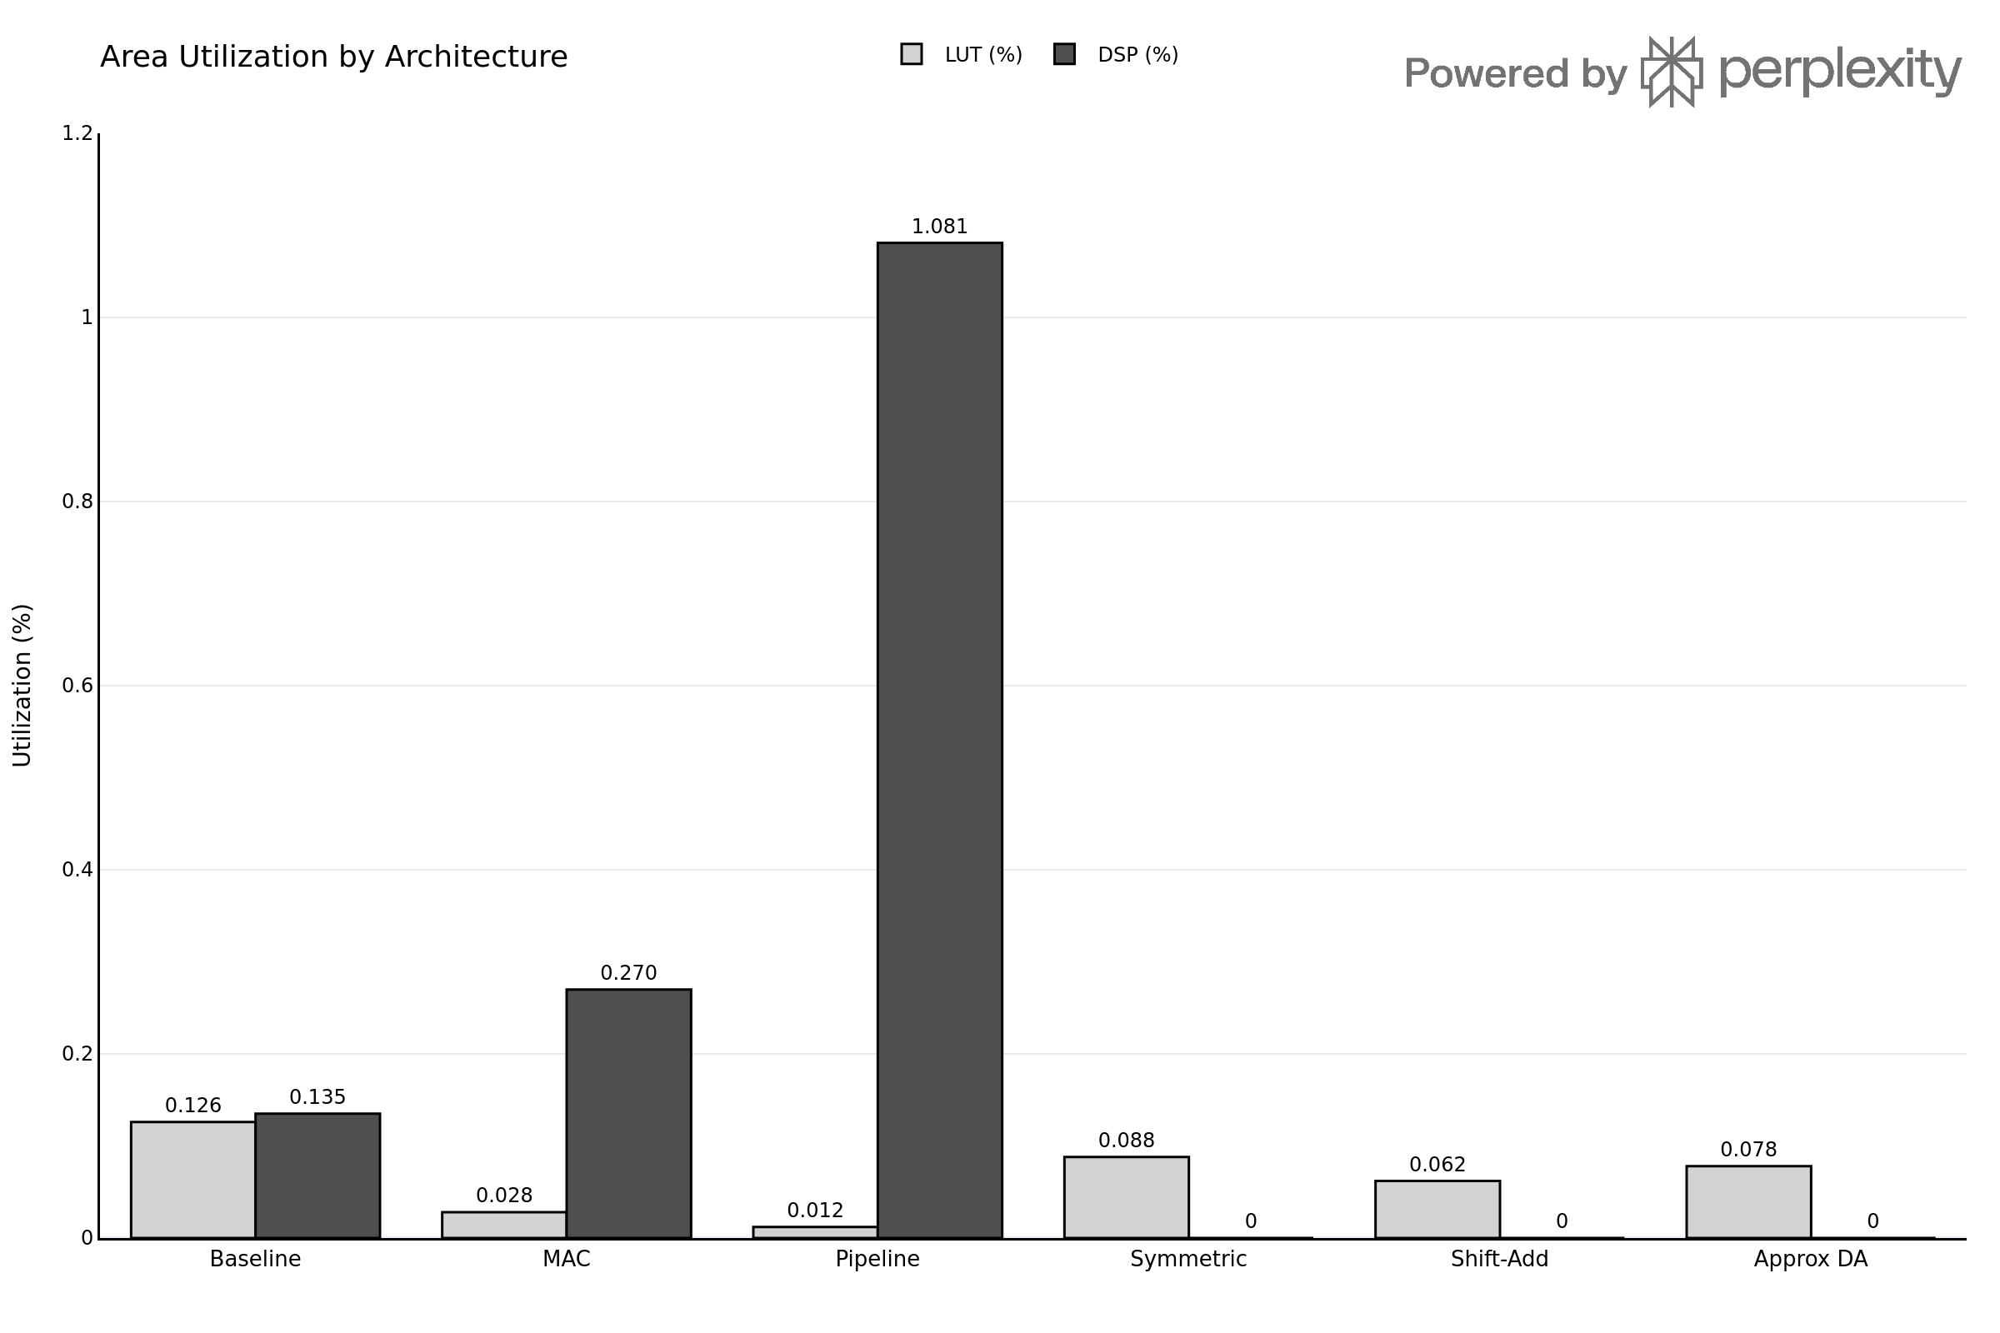
Results: DSP & LUT Area Utilization
• Baseline and Pipelined architectures aggressively consume DSP budgets.
• Approximate DA completely eliminates DSP usage (0%) while maintaining low LUT usage (<0.1%).
Notes:
Speaker 2: Point to the graph. Show how the DSP bars (dark gray) drop to literal zero for the last three designs.

Slide 11
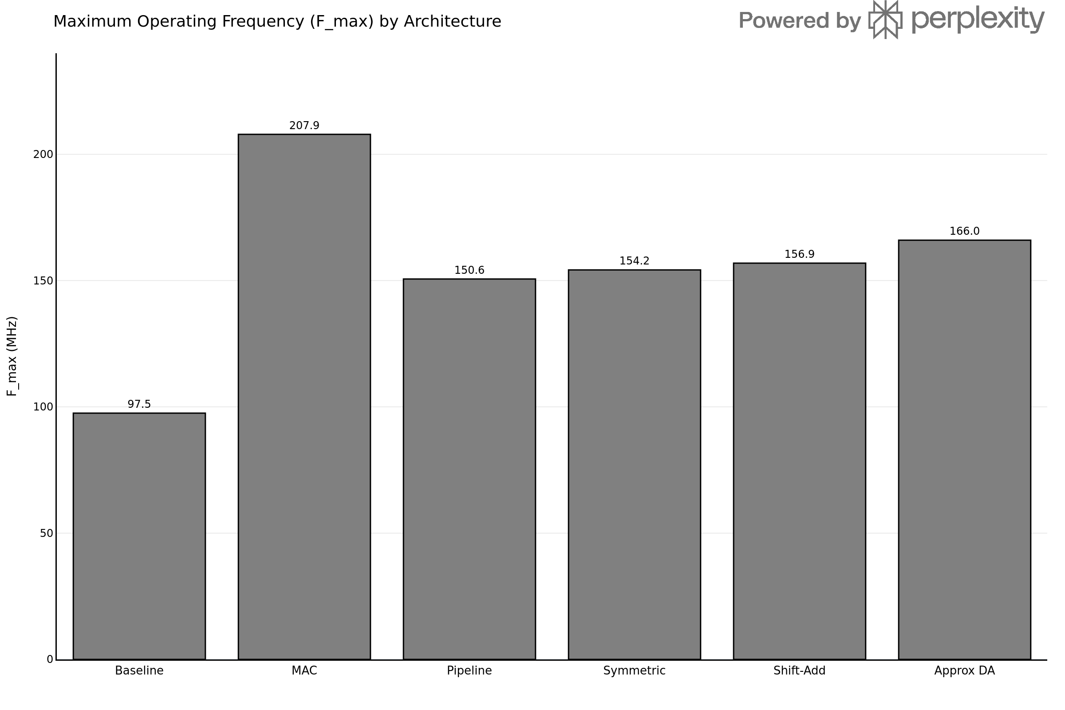
Results: Operating Frequency (F_max)
• Baseline fails timing closure (97.5 MHz).
• Folded MAC peaks artificially due to small combinational depth.
• Approximate DA achieves 166.0 MHz as a fully parallel, single-cycle architecture.
Notes:
Speaker 2: Explain the Fmax scaling. Remind the audience that the 166 MHz of Approx DA is a true single-cycle 166 MSPS throughput.

Slide 12
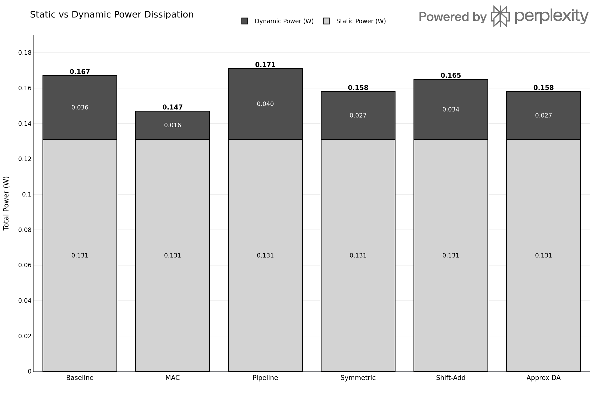
Results: Power Dissipation
• Pipelining burns the most dynamic power due to heavy flip-flop and carry-chain toggling.
• Approximate DA minimizes dynamic power by fracturing the carry-chain via LOA adders.
Notes:
Speaker 3: Show the power stack. Static power is constant across the fabric, but we crushed the dynamic power component.

Slide 13
Conclusion: The Pareto-Optimal Point
• The Approximate DA datapath achieved:
- 0 Dedicated DSP Slices
- 166.0 MSPS Effective Throughput (6.3x faster than Folded MAC)
- < 1 mW Internal Logic Dynamic Power
• Strategically trading exact math for approximate logic yields the ideal edge accelerator.
Notes:
Speaker 3: This is the mic drop. Summarize the thesis in these three bullet points.

Slide 14
Scope for Future Work
• RISC-V Coprocessor Integration via AXI4-Stream interface.
• Adaptive Filtering: Implementing an LMS weight-update hardware block.
• ASIC Standard-Cell Synthesis (e.g., TSMC 28nm) for raw silicon area comparison.
Notes:
Any speaker: Conclude with where this research can go next. Hand back to the examiners.

Slide 15
Thank You
Questions?

